Slide 1
Federal Funding Opportunities for Theatre Education
Notes:
Hello. Welcome to the Funding Opportunities for Theatre Education Webinar. I’m James Palmarini, EdTA Policy and Advocacy Advisor. In this short presentation, were going to walk through two federal funding streams that theatre and other arts education are eligible to apply for in 2021 and beyond.

Slide 2
The Elementary and Secondary
Education Relief fund (ESSER)
&
Title IV A
Notes:
The federal funding programs were going to address here are the Elementary and Secondary Relief fund and Title IV A.

Slide 3
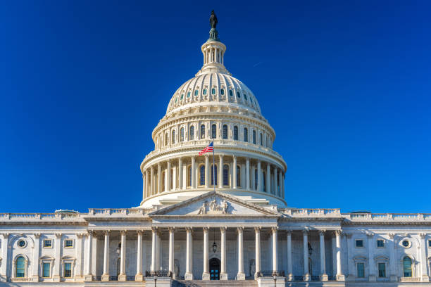
Some reflection: why the federal picture matters now
???
Notes:
First a bit of reflection: In past years, one of the biggest challenges I’ve had is communicating why what happens in Washington and at the Department of Education has anything to do, really, with what happens in a school, in a theatre classroom, on a stage, that impacts teachers and students.

Slide 4
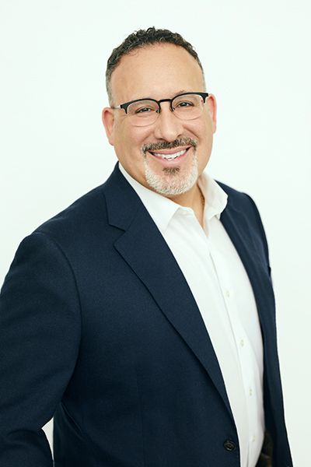
A new day in DC
Newly appointed Secretary of Education Miguel Cardona is a former teacher, principal, and district administrator. Known as a consensus builder, he grew up in public housing and did not speak English as a child
Notes:
But this year its different. A new day so to speak. READ SLIDE…..
And he and the Biden administration want to do thing differently.
And how they do them—as we move into the post-pandemic era of education—could not be more important.

Slide 5
The big picture—the path
Notes:
This simple graphic reminds us all what we already know about the big picture of federal funding of public education. But the path by which this money finds its way to teachers and students is still worth reviewing.
Federal funds are allocated as part of the annual budget created by the administration in power and passed by Congress and then the funds make their way to the state , the district, schools, and hopefully, into programs across all curricular subject areas---including the arts.…. READ THROUGH BOXES, THEN,
How this gets done has often been confusing but learning how to cut through that confusion and understand how specific federal education dollars can be granted to support your program is what we’re here to talk about.

Slide 6
The big picture—DOE priorities & strategies
Teaching practices that increase and accelerate learning
Inclusive and safe learning environments
Summer school & enrichment opportunities
After school & extended day learning
Evidence-based approaches
Evaluation and assessment of investments (ROI)
Notes:
And again—a new day. The Biden administration has been very clear and specific about their priorities for public education in this country. To wit:
READ ONE AT A TIME AND WITH
Teaching practices….. That is, they are interested in innovation and pedagogy that thinks about out of box, that can adapt to meet the needs of all students
Inclusive and….
After School….
We all know what a challenging year plus it has been—in so many ways, not all of which can be attributed to the pandemic. The admin is seeking to follow the original spirit of the 1965 ESEA, which to read it and meet it as civil rights issue and that all students should have the opportunity for equitable access to a quality education. That, and the assurance that traumatized students can feel safe enough to re-enter a positive learning space.
Summer school & enrich.. With remedial education top of mind for the foreseeable future, the admin wants to essentially make school year round—no lapse in teaching no lapse in learning provided by, for us, teachers and Tas, with community support
Evidence based approaches
Eval & Assessment
Essentially what does learning look like and sound like—certainly theatre knows all about that….and measuring that learning to eval ROI

Slide 7
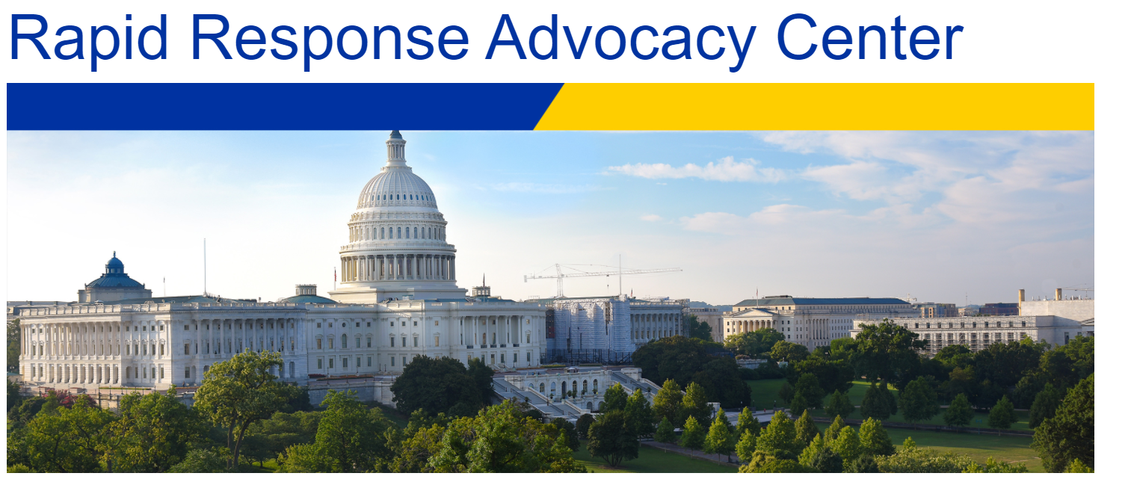
Notes:
Before we begin our overview of ESSER and Title IV A, here’s two EdTA resources addressing the federal funding focus of this presentation.
One, on our website, under Advocacy, in the Rapid Response Center you’ll find the EdTA ESSER and Title IV A Guides that detail everything I’m covering here, along with some other important details and links.

Slide 8
Notes:
And two, on the EdTA professional development page, TE Pro, you’ll find additional resources about ESSER and a link to a related blog I created and shared in the EdTA Community

Slide 9
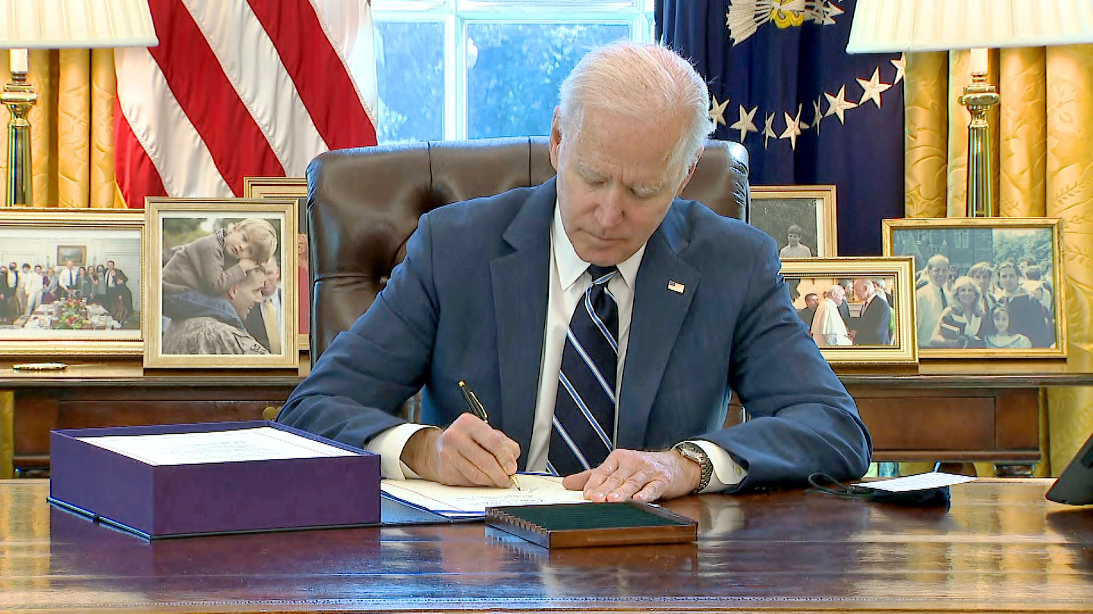
The Elementary and Secondary Education Relief Fund (ESSER III)
Notes:
The Elementary and Secondary Education Relief Fund—otherwise known as ESSER III or sometimes, the American Rescue Plan Act—is part of $1.9 trillion economic stimulus package signed into law by President Biden in March to help school districts throughout the country stabilize their budgets after deep cuts prompted by the pandemic.

Slide 10
ESSER I= $13.2B
ESSER II= $54.3B
ESSER III= $122.6B
Notes:
There have actually been three education stimulus packages in the past year and a half: READ SLIDE.
Districts have already received and distributed ESSER I and II funds. While in some states ESSER II funds are still being allocated, for the most part administrators are focusing on ESSER III funds, which is we’re here to talk about.
And it’s also worth mentioning that the proposed 2022 Department of Education budget of $102.8 billion, is the largest in history. In total, this money represents an unprecedented level of federal support for public education.

Slide 11
The big picture—ESSER III
Perspective: Each school district that receives annual Title I-A funding will receive around 8 times their usual allocation in ESSER III
Limitation: ESSER III funds MUST be allocated to districts and spent by September 30, 2024
Notes:
Here’s some perspective about this funding and an important limitation about it as well.
READ SLIDE

Slide 12
ESSER & Theatre Education
The law identifies 15 types of allowable uses for ESSER funds, beginning with “any activity authorized by the ESEA of 1965.”
That means that if funding is authorized under any well-rounded education programs, that allocation will be allowable with ESSER funds as well—including for theatre education programs, teachers, and students.
Notes:
READ SLIDE AND ADD
You can see the full list of allowable uses in the EdTA Guide to ESSER in the Rapid Response Center.
Additionally, ESSER funds can be used to support other federal education laws which help some of your students, including the Individuals with Disabilities ACT (IDEA); the Perkins CTE Act; and McKinney-Vento Homeless Assistance Act.

Slide 13
ESSER & Theatre Education
These dollars are allocated to school districts based on the Title I funding formula. The funds, however, are NOT considered Title I funds, and do not have to follow Title I funding restrictions.
Notes:
Important to know READ SLIDE
In other words, they only must meet one of the 15 allowable activities listed in the Funding Eligibility for Well-Rounded Subject Areas document.

Slide 14
ESSER Theatre Funding Examples
Masks or other protective equipment for use in the theatre classroom (allowable under #3, #5)
Training for theatre educators on strategies to conduct in-person theatre instruction safely (allowable under #6)
Supplies to sanitize technical equipment (Allowable under #7)
Notes:
What exactly are we talking about in terms of funding under the “allowables”? Here’s some examples READ RED

Slide 15
ESSER Theatre Funding Examples
Devices for internet connectivity, laptops, and/or supplemental software for instruction & assessment virtually (Allowable under #9)
Supplemental instruction, such as through a teaching artist, to provide remediation in theatre (Allowable under #11)
Materials to create a safe theatre classroom with physical distance between students such as masking tape, plexiglass or outdoor tents (Allowable under #12)
Notes:
READ SLIDE
You can see other examples and how they align to the 15 allowable ESSER statutes in the EDTA Guide to ESSER.

Slide 16
Important ESSER III facts
To receive funds a school must be classified as Title I or be in a district that has a Title I school.
Private schools are eligible to apply for ESSER funds under a separate fund.
ESSER funds CAN pay for theatre teacher positions that have been cut or threatened with elimination
Notes:
READ 1 THEN
If you are NOT a Title I school but there is Title I school in your district, you will have to make a stronger case, likely around inequity, as to why your school and program should receive the funds, rather than the Title I school.
READ 2 THEN
Under ESSER III, each states’ department of education provides funding to nonpublic schools that enroll a significant percentage of children from low-income families and are most impacted by COVID-19.
READ 3 THEN
even if the positions were paid for with local and state funds in the past, ESSER funds can help support teacher salaries. However, it’s important to know that these positions may again be at risk once the funds are exhausted in 2024.

Slide 17
Title IV A
Student Support and Academic Enrichment grants
Notes:
Now, we’re going to talk about Title IV A, otherwise as Student Support and Academic Enrichment grants

Slide 18
The big picture—Title IV A
Provide all students with access to a well-rounded education—including in the arts.
Improve school safety for student learning.
Improve the use of technology to improve the digital literacy of all students.
Notes:
In 2017, the federal education law, the Every Student Succeeds Act created Title IV A, a new funding stream designed to improve student achievement through three specific strategies—READ SLIDE

Slide 19
Title IV A is a permanent
Department of Education fund!
Notes:
This Title federal fund flows through each state’s department of education to school districts.
And the important thing to know is that, unlike ESSER II, these funds are permant and unlikely to go away, as Congress as demonstrated bi-partisan support for funds since enactment.

Slide 20
Title IV A
$1.6B in 2021
Proposed level funding for 2022
The Title IV A Coalition has suggested $2.2B
Notes:
And in fact, the allocated amount has increased annually since 2017. READ SLIDE

Slide 21
The big picture—Title IV A
Districts Title IV A applications grant applications in the spring of each year and generally are processed by the beginning of the new school year.
Districts receiving at least $30,000 in Title IV, A funding must commit to at least 20% of their grant be applied to each of three designated areas of technology, safety, and well-rounded subject areas.
Districts receiving less than $30,000 in Title IV, A funding only need to meet one or more factors
Districts are required to complete a Needs Assessment to determine where Title IV, Part A funds can be used.
Notes:
READ SLIDE
ON LESS THAN $30K: For example that the school has a high percentage of high-poverty students, or has been consistently identified as a high risk environment.
ON NEEDS ASSESSMENT: The district must prove that the Title IV A funds are not supplanting local funds that are already available to pay for a specific request. Perhaps you would like new lights for your auditorium and the district simply does not budget for equipment upgrades.

Slide 22
Title IV A Theatre Funding Examples
Personal Protective Equipment
Teacher professional development such as conferences, in-service, or workshops
Adding or expanding Theatre courses
Resources, software, and textbooks and/or scripts
Stage technology—boards, lights, audio equipment, etc.
Facilities upgrades—seating, curtains, storage, etc.
Notes:
READ LIST
These are not any different from what you might ask for in an ESSER application, except in one very important way: Title IV A funds CANNOT be used for pay for staff.

Slide 23
Title IV A—facts
These federal funds are meant to be supplemental in nature – not to supplant what is already provided locally.
To receive Title IV A funds a school must be classified as Title I or be in a district that has a Title I school.
Title IV A funds DO NOT carry over from one year to the next.
Notes:
READ 1 THEN
For example, if you would like to buy a new sound board you would show the value of using these federal dollars by explaining that there are no local dollars to cover the purchase and that it is essential to your curriculum.
READ 2 THEN
The same eligibility rules that apply to ESSER are in force for Title IV A
READ 3 THEN
Making a request for these dollars for your program has to be done through a new application annually.

Slide 24
Applying for federal funds—four steps
Find out who is responsible for managing your district’s federal funds
Notes:
While you, as an individual educator, are not eligible to directly apply for ESSER or Title IV A funds, your school CAN through the district office.
And remember, the application timeline for ESSER funds and Title IV A funds are different—ESSER application is currently ongoing; Title IV A fund application are done annually in the spring
The first thing you need to do as an advocate for your program is to find out who is the federal programs administrator or Title I Director responsible for managing the funds in your district.
That individual will likely be the point person for both ESSER and Title IV A fund. It could be a school or district curriculum coordinator but if you are in small or rural district that might be the school principal or even a department head.

Slide 25
Applying for federal funds—four steps
2. Do a needs assessment of your program
Notes:
Before you reach out to ask how your theatre program might receive federal money, do a needs assessment of your program. That way, you can present a clear and specific ask for funding that will ensure that your theatre students will have the best opportunity to grow their knowledge and skills in the art we all love.
A good resource to help in your program evaluation is the 2016 EdTA Opportunity-to-Learn Standards for Theatre Education—otherwise known as the OTLS, which addresses the necessary resources and equipment, staffing, curriculum, facilities, and safety needed to deliver a quality theatre education experience to all students. You can find the OTLS under the EdTA website resource tab.

Slide 26
Applying for federal funds—four steps
Do you have a need for additional personal protective equipment to help students return to theatre classes and performance in person?
Do you have need for such things as additional scripts, textbooks, or shop tools, so students do not have to share them, to create a safer learning environment?
Do you have needs for ways to reach and engage students who have not been successful in virtual or hybrid learning situations, such as instruction by a supplemental theatre educator or teaching artist?
Do you have ideas on summer learning opportunities that can include theatre – both for students already engaged in your programs and for those who haven’t been participating?
What do you need to teach and ensure theatre student learning in a safe and nurturing environment?
Notes:
You might start might your needs assessment by asking yourself this fundamental question—READ SLIDE
THEN OTHER QUESTIONS, ONE AT A TIME.

Slide 27
Applying for federal funds—four steps
3. Ask for a meeting with the federal program’s manager
Notes:
Whoever is responsible for building your school district’s ESSER funding request should be able (and willing) to discuss the needs of your theatre education program for the fall and your ideas for summer learning. You may also want to invite your principal or other administrators engaged in your theatre program to this meeting.
Be prepared to provide the evidence of your needs that you have assembled in your program review, including research to back up any pandemic mitigation and learning loss strategies and associated costs of what you are suggesting.

Slide 28
Applying for federal funds—four steps
4. Try try again if your request is denied
Notes:
As you work with your federal programs’ person or staff in your district, remember that they are working to balance needs in all subject areas and across all the district’s schools. So, if you are told no, ask if it’s possible that the needs that you have listed for your program might available later.

Slide 29
Reality check
Funding and academic priorities
Reduced state education budgets
Community economic hardship
Limited federal dollars
A volatile political environment
Notes:
READ EACH THEN….
Funding arts education is not likely a priority in your district. There is going to be lot of emphasis on remedial education to compensate the perceived learning loss that many student suffered under the pandemic. That could at the expense of arts education.
Some states are reducing education budgets and using ESSER money to temporarily backfill their budgets and allocations to districts. What that might mean a year, two year, and so on down the road is unknown, given the unpredictability of state economies.
Many districts, particularly those in high poverty areas, have suffered a serious community economic downturn prompted by the pandemic. The pandemic resulted in a substantial loss of revenue given the number of businesses that failed or shuttered. That, in turn meant less dollars in community coffers—money needed for basic city services as education.
We are in a volatile political environment—a change in Congressional leadership in 2022 may compromise or change the educational goals of the current administration and 2024 could also alter the federal commitment to public education.
….

Slide 30
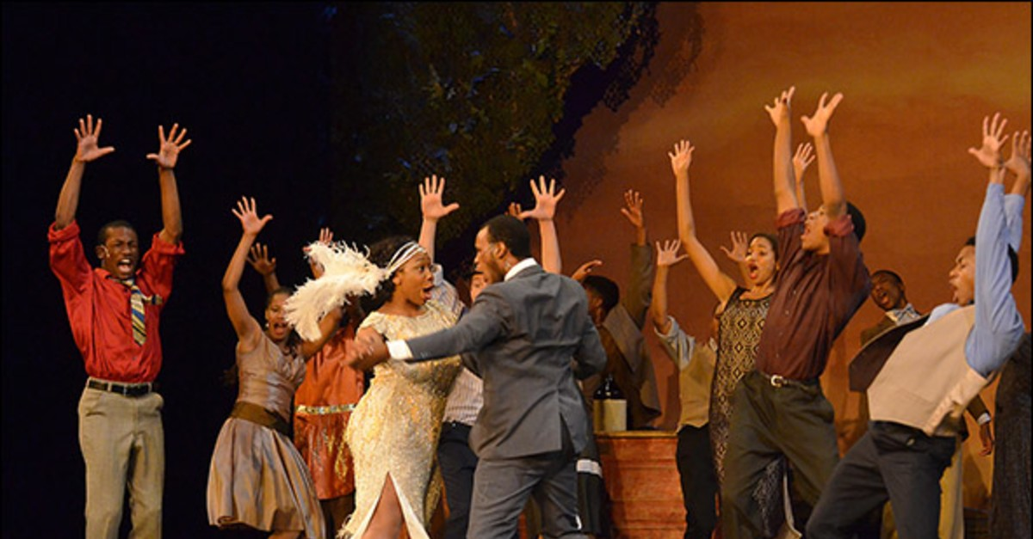
Yes—it is possible
YES!
Notes:
We all know what challenging times these are, but as we move into a post pandemic era, you will be back in the classroom, you will be teaching student to become the theatre artists you know they can be, you will be producing shows and welcoming audiences again, so why not dream for a minute and imagine you had the funding you needed to create the program you know would give best opportunities for your students to be all that they can be? Then, go after the money. You, your students, and your school community deserve it.

Slide 31
Thank you!
Questions?
jppalm48@gmail.com

