Slide 1
Top Ten Tips for a Virtual Performance Pre- Production
Notes:
Hello and welcome to EDTA’s Top Ten Tips for a Virtual Performance
We understand that your productions may look and be different in this COVID-19 world, so we’re going to cover a few tips and tricks to help you better plan your season and production.

Slide 2
PRE-PRODUCTION
We are going to cover a few tips in this section as a primer to Virtual Performances.
Notes:
Please understand that the tips that we are going to be talking about and being presented do not fully represent and cover all techniques, but it will sure help you get started and give you things to think about.

Slide 3
Top Ten Tips for Virtual Performance
Pre-Production
File Naming & Organization Structure
Planning Your Season
Rethink Virtual Performances as a Unique Genre
Notes:
We have broken the Top Ten Tips into three different presentations; Pre-Production, Rehearsal/Tech, and Performance. The topics we’re going to cover today we believe fit more in the pre-planning stages of creating your virtual performance.

Slide 4
Topics Covered
- creating a file naming and organization structure to keep track of student work in progress
-planning your season with plays that translate well into a virtual realm
-remembering that virtual performances are not simply recording a zoom meeting where students perform.
Notes:
The three topics we are covering in this specific presentation are;
Create a file naming and organization structure and work in progress; this is especially important if you are working with pre-recorded video clips to edit together a performance.
Plan your season with plays that translate well into a virtual realm: plays with flashbacks, memory scenes, etc. that may lend themselves to video effects. Don’t overlook the growing list of plays written to be performed in “Zoom” type conditions.
Remember that virtual performances are not simply recording a Zoom meeting where students perform. Rethink virtual performances as a unique genre and challenge yourself and your students to think about “playing in the frame”.

Slide 5
File Naming & Organization Structure
Keeping track of work and work in progress.
Notes:
Our first topic is discussing your file naming of the files you record, edit, edit, and edit also the organization structure of keeping everything you film in order.

Slide 6
File Naming & Organization Structure
File naming & organizing those files is the most important step that you need to decide on with your entire production team.
Make sure you have edited the script and all production team members are using the same script.
Page numbers and scenes really come into play if you are filming scenes to be accessed at a later date.
Notes:
The most important step is that of determining what your file structure is going to be and how you are going to organize those files in a log book-you are going to have to manage hundreds of files and keeping a great log book will help you out tremendously in the editing section.
After choosing the script, make sure the edits are all done before filming-if not it’s going to become very confusing in referencing page numbers and lines.
These page numbers come into play because they all become a reference point in the editing process and lining up each of the scenes and lines.

Slide 7
File Naming & Organization Structure
4. This creates a unified system across the board and will save time and minimize headaches down the line.
5. Assign a production manager or stage manager to handle distribution of the script to all production members.
6. Your stage manager/production manager need to be the point of contact for everything in regards to schedule, script, meetings, correspondence, etc.
Notes:
4. Once you have a unified system-explain the system to the entire production team because then everyone is and stays on the same page in the filming process, naming files, and how they are labeled and archived.
5. It helps to assign a production or stage manager to handle all of this to become the point of contact and answer any and all questions about the log book or file naming structure.
6. Make sure that your stage manager is great at organization and can multitask-this job is very important since they are the central part of your production when it comes to communicating with the other production team members-especially in a virtual world.

Slide 8
File Naming & Organization Structure
7. Assigning multiple people to the management team will help out and then tasks can be delegated.
8. It’s highly encouraged to pick a file sharing website that everyone has access to and can store a lot of files.
9. When choosing this file sharing site, make sure to choose one that has different levels of sharing (i.e. Viewer, Uploader, Editor with functions)
10. Make sure that everyone has access, create an exercise.
Notes:
7. It may be best to have a team of students that is going to help the production/stage manager out by dividing up the various communication and organization of your performance. It can be a daunting task for one person to go in it alone, and you then also have backups in case they get sick.
8. Make sure that when you pick your file sharing website that everyone can access it (no fees, free, etc.) A lot of districts have agreements with certain file sharing systems or it may be a part of your communication software that your district uses. If not, it’s best to contact your IT person to see if there are any deals that your district has with file sharing websites. Please also make sure that it has a lot of storage since your files could easily be multiple gigabytes each.
9. In your choosing the file share website check if there are levels of access that you can give to your members… this is key when you don’t want some students to download your play or musical and share it themselves. It can also prevent accidental deleting files or uploading files.
10. Check that everyone has access to your file sharing by creating a simple exercise for them to do; it could as simple as-creating a folder, renaming it, and uploading a picture of themselves.

Slide 9
File Naming & Organization Structure
11. Naming your files is very important to the entire process.
12. If you have your filming/shooting/recording schedule, it’s best practice to create a document (i.e. log sheet/book) that can organize each file by date, name, type, characters, and takes.
13. In your files, it may be best in the filename to include scene numbers, script page numbers, dates of edits, and initials of who edited the video.
Notes:
11. Naming your files is very important because you want to make sure that everyone understands the file name, and that it relays certain information without having to open the file and watch it to determine scene, characters, etc.
12. Creating a log sheet or book as you film helps out a lot with organizing file names and when they were shot, what characters were in each of the shoot, if there was more than one take, or if there needs to be a re-shoot.
13. For your filename-I have found it best to include the scene number, script page numbers, date of filming, or date of that edited file along with their initials to know who edited it.

Slide 10
File Naming & Organization Structure
14. Make sure that every take is slated or you can use a clapboard to write out the slating, so that just in case the filename is mixed up-there are active markers in the take.
15. It helps to have the entire production team in on the file naming process of what is going to be easiest.
Notes:
14. Make sure that every actor/character or your director slates before the scene and it might be best to use a clapboard so that information is at the beginning of your footage so that in case the filename can’t be read or file undetermined-you have a backup system that identifies that file.
15. When the entire production team knows exactly how to label a file-then there leaves no room for unexpected files or questions about files in the process.

Slide 11
Planning Your Season
Picking plays that translate well into a virtual realm
Notes:
The next topic is planning your season and picking plays to perform in a virtual format. There have been a lot of playwrights and royalty companies that have put out guides on their website to help you choose.

Slide 12
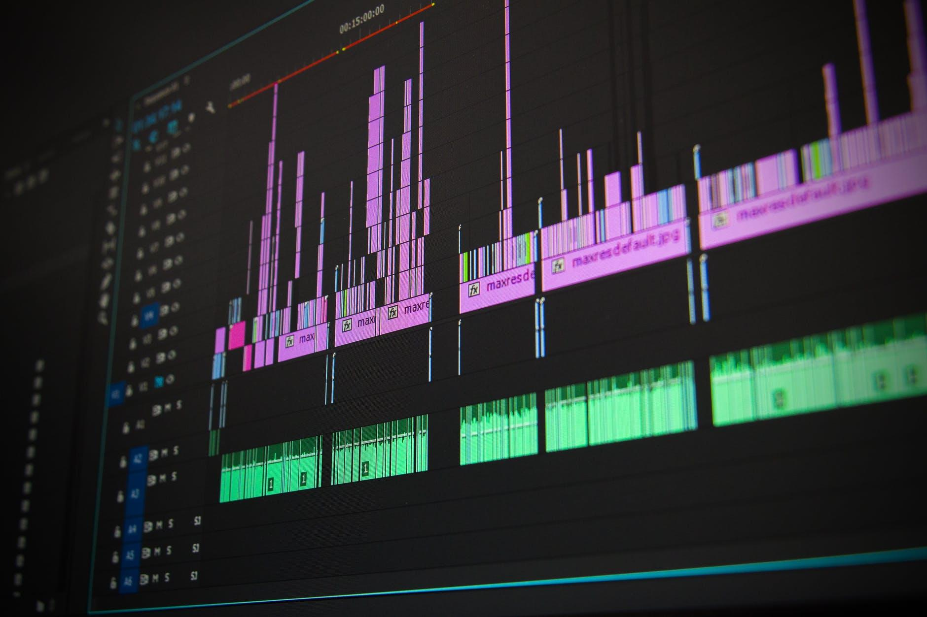
Planning Your Season
Think outside the box when it comes to titles.
There are a lot of titles that have been converted to do on many of the virtual platforms like Zoom.
Plays with flashbacks, memory scenes, and smaller casts that can be translated and may lend themselves to add video effects to your performance.
Notes:
Think outside the box when it comes to choosing a play that is to be performed virtually. Can the scenes or storyline be turned into a social media extravaganza by way of zoom call, meeting, phone call, dream sequence, or updated?
Check out all the titles that have already been converted into performing in a virtual space, and read each one to get a feeling for how simple or complicated that title might be. If you know the play has a lot of characters-is your system and the students internet going to be able to handle that much bandwidth?
If your play calls for flashbacks, memory scenes, smaller casts-you can use video effects for all of the scenes that might usually be a special lighting moment or sequence onstage. We are going to cover how you can achieve those effects in the next presentation Rehearsal/Tech.

Slide 13
Planning Your Season
4. Don’t overlook the growing list of specific plays that are written to be performed virtually.
5. A lot of Shakespeare’s canon lends itself well to be used as a script for virtual work.
6. It’s free, multiple characters could be played by one person, and you are allowed to edit the play without written permission.
Notes:
4. Don’t overlook some of the plays that you may think are too cheesy-or that are done in the canon of theatre too often. Remember that your audience wants to see art and especially in this climate-they will support the production.
5. We love Shakespeare-why? Because it has a lot of monologues, dream sequences, and can be adapted easily to be performed virtually.
6. Plus, why else do we love Shakespeare? BUDGET friendly… it’s FREE. You can also edit the show without written permission to a royalty company.

Slide 14
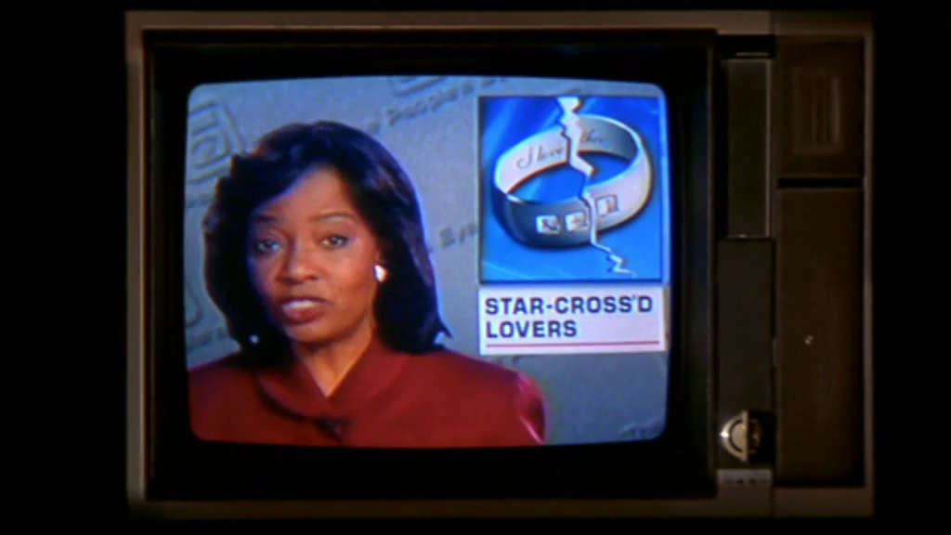
Planning Your Season
Let’s take Shakespeare’s Romeo & Juliet for instance…
A play about two families and the forbidden love between two characters. How could this be updated? Does it translate well to today? Are there any situations that we could relate this story to current time?
As an example of how it can be updated, check out Baz Lurhmann’s 2001 film adaptation.
(https://youtu.be/beV56hp4T3w)
Notes:
An example of using a Shakespeare play might be Romeo & Juliet
This play lends itself for an awesome updated topical drama that delivers on the suspense and is easily translated virtually by delivering the storyline in different modalities.
A great example of how Romeo and Juliet was updated is to take a look at Baz Luhrmann’s (Strictly Ballroom and Moulin Rouge director) version.

Slide 15
Rethink Virtual Performances as a Unique Genre
Remember that virtual performances are not simply recording a Zoom meeting where students perform.
Notes:
The last topic that we are going to cover in this presentation is rethinking virtual performances and how they are delivered to your audience. The end goal is to present the best possible production and keeping the audience engaged.

Slide 16
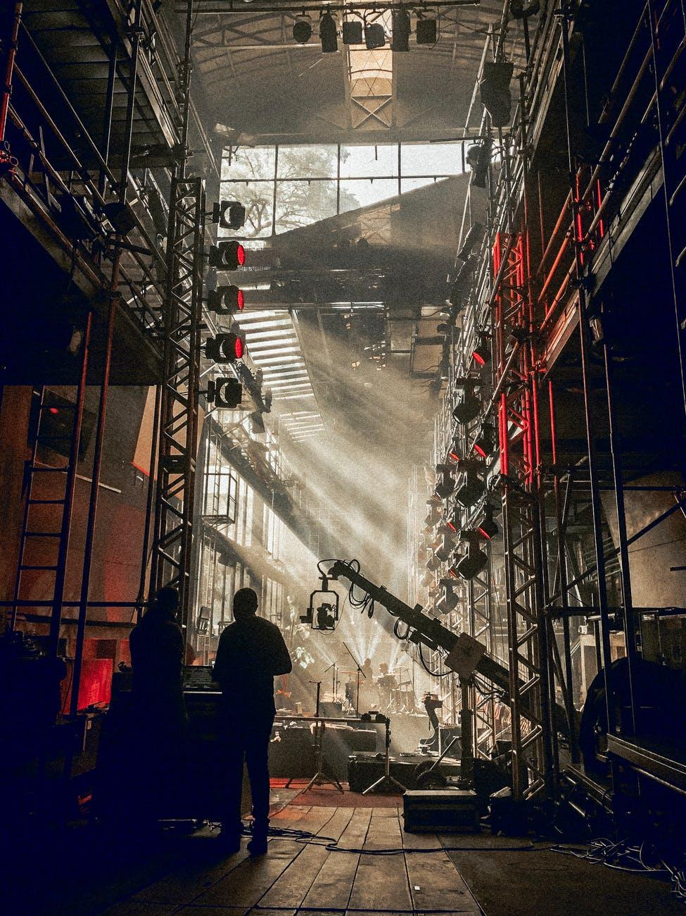
Rethink Virtual Performances
Make sure your students are playing in the frame.
Take a look at some of your favorite movies and tv shows and look at how they frame the person, object, etc. throughout the piece.
A lot of the time the frame changes and helps with transitions and to further the storyline.
Notes:
Make sure your students are playing inside the frame of the camera-you can alternate those positions… for instance-let’s take Romeo and Juliet-if they’re reciting the balcony scene you could put Romeo on the left ⅓ of the frame and Juliet in the right ⅓ of the frame to help tell the story.
Look at your favorite movies and tv shows to get inspiration when it comes to putting your acting in the frame-I’ll give you a hint they utilize the entire frame and change it up every scene.
Frame can also help you out with transitions and to further the storyline-this can also be achieved by using the zoom on your camera or a combination of zoom and pan. Pan is the left and right motion of camera movements.

Slide 17
Rethink Virtual Performances
4. Think back to your theatre...we have the natural frame of the proscenium or 4th wall.
5. If we equate the frame to stage directions, then we have a universal language to use with actors-divide it into acting areas.
Notes:
4. When you think about the frame-we can think of it in theatre as the 4th wall or the proscenium-what is in frame and what is out of frame? Is the prop or character intentionally just in frame to foreshadow an upcoming scene? Or is the frame serving as a side wall, mirror, or or other scenic piece?
5. It helps to equate the frame into stage directions and divide it up-in the links section-you’ll see examples of how to divide the frame up.

Slide 18
Resources - Links
File Sharing
Planning Season
Virtual Performances
www.dropbox.com
www.box.com
www.sharefile.com
https://www.google.com/docs/about/
www.sharefile.com
www.docsend.com
https://www.microsoft.com/en-us/microsoft-365/onedrive/online-cloud-storage
https://www.dramaticpublishing.com/browse/livestream
https://www.dramatists.com/text/covid19updates.asp
https://www.playscripts.com/livescreen-theatre
https://www.showtix4u.com/#streaming
https://www.theatricalrights.com/
www.cnet.com/news/with-real-theaters-closed-actors-are-turning-to-virtual-reality/
https://youtu.be/MfIanZimZR8
https://youtu.be/fM64ycm7tz4
https://youtu.be/HMjvvltQpmw
Notes:
We included a links slide to help you out with websites to guide you in further detail on the topics we covered in the presentation,

Slide 19
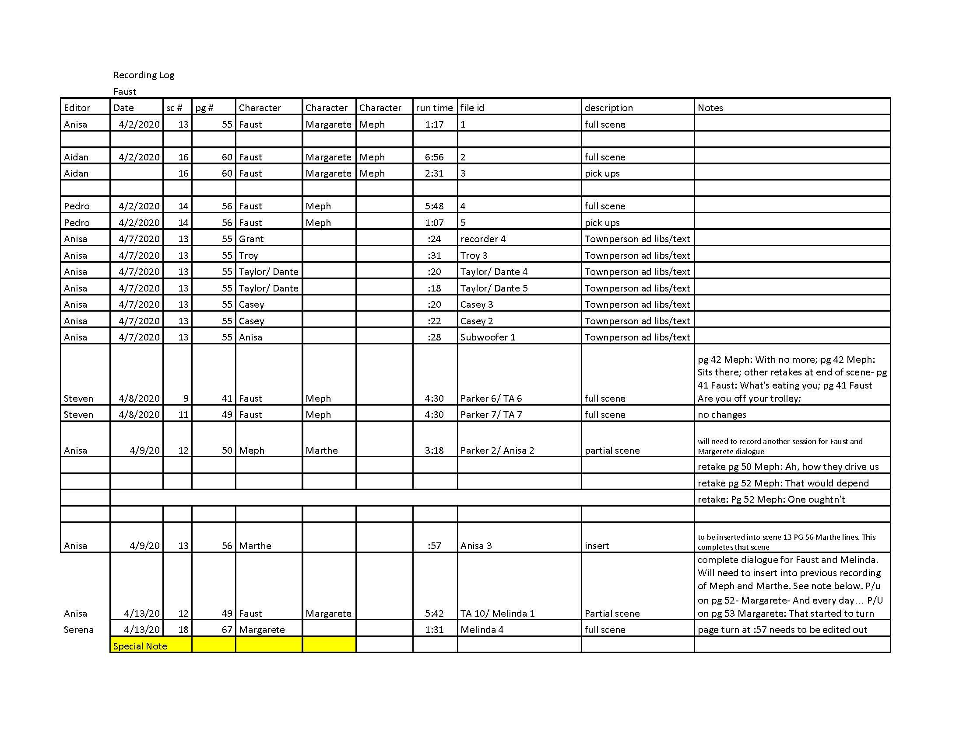
Examples - Recording Log
Notes:
We’ve also added examples of the recording log here, this was from a production of Faust at the University of Texas at Dallas that was presented as a radio play last spring.

Slide 20
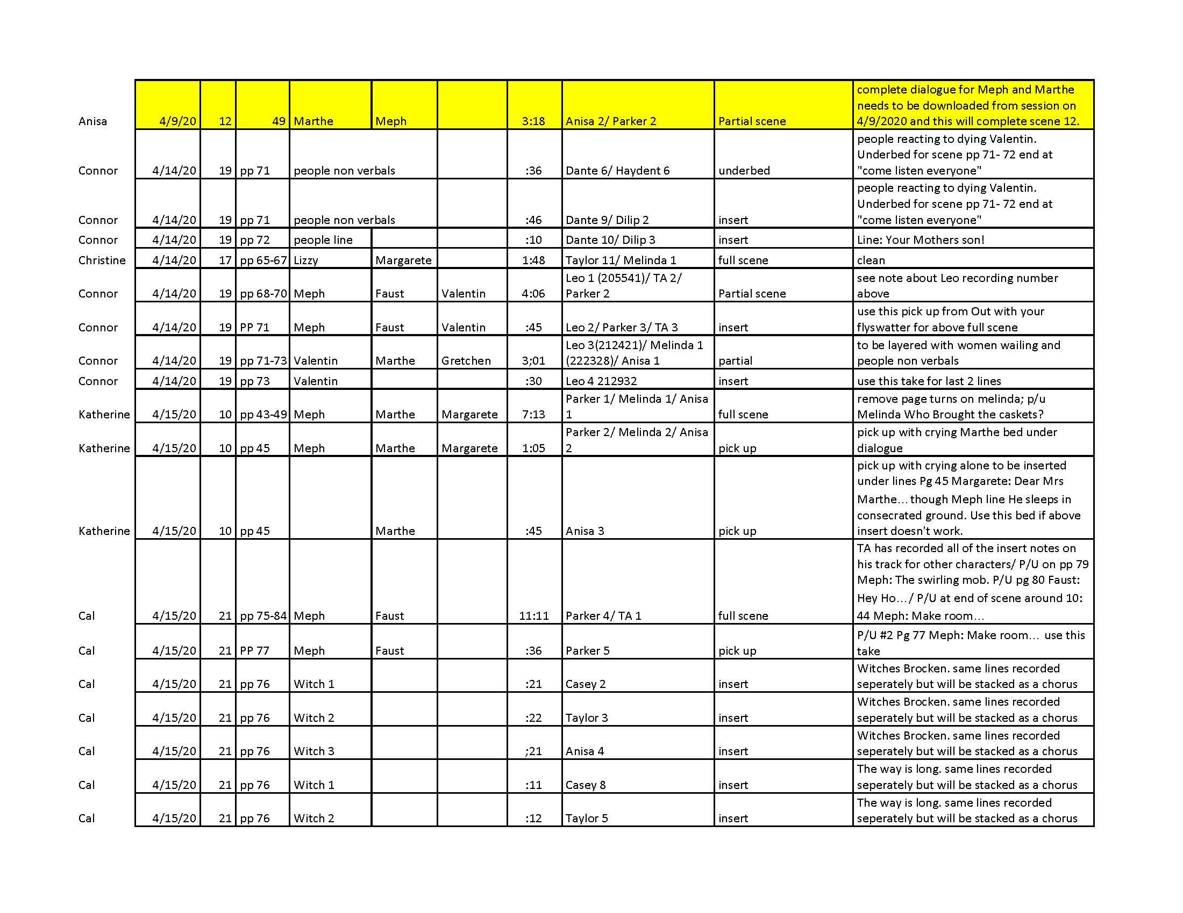
Examples - Recording Log
Notes:
You can see all the details that were made on this specific sheet of the recording and it was used as a form of communication from the director as to what was recorded and complete for the next day to start the editing process.

Slide 21
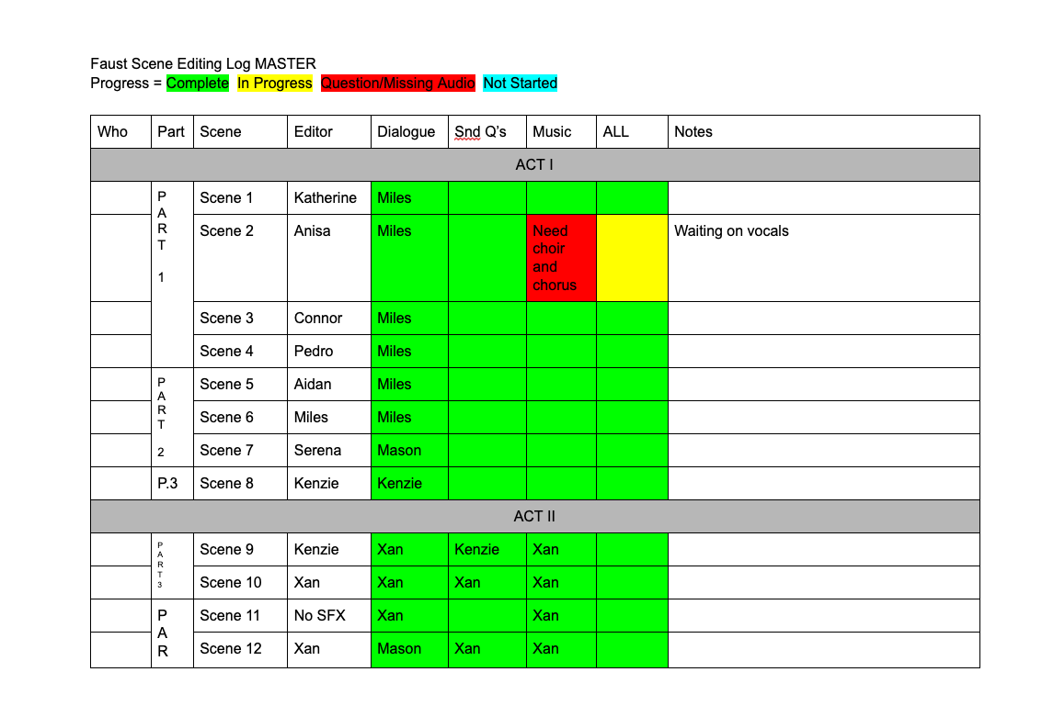
Examples - Editing Log (Crew)
Notes:
This editing log was used by the technical directors and students that were editing each scene to have a real time check in process of what scenes were complete and what scenes still need certain aspects added.

Slide 22
Examples - Editing Log (Production)
Notes:
The stage manager created this editing log so that the director, composer, and sound designer could all make notes on scenes after listening and communicate those to the crew-it also told those entities when the edits were completed by using a color coded system.

Slide 23
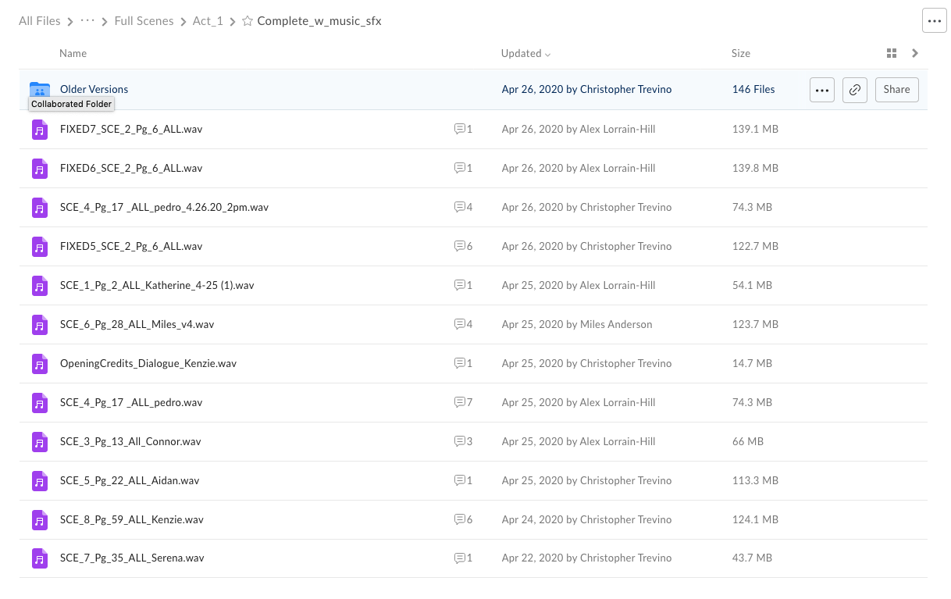
Examples - File Names
Notes:
These are examples of our file names from our Box.com file sharing website.

Slide 24
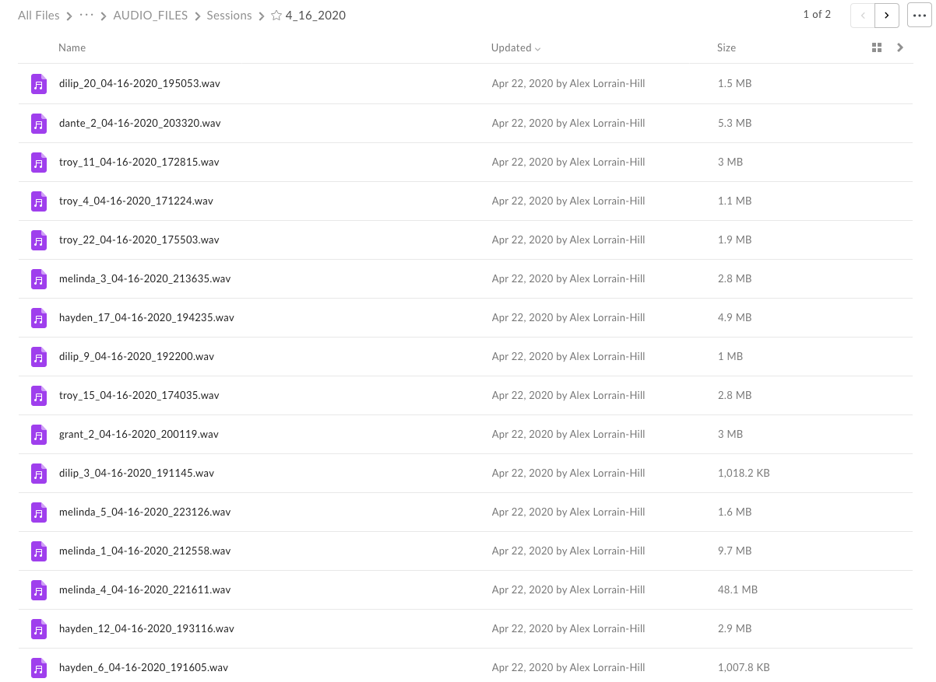
Examples - File Names
Notes:
We had two separate folders of completed files and would copy them to the edit folder so that the originals stayed intact.

Slide 25
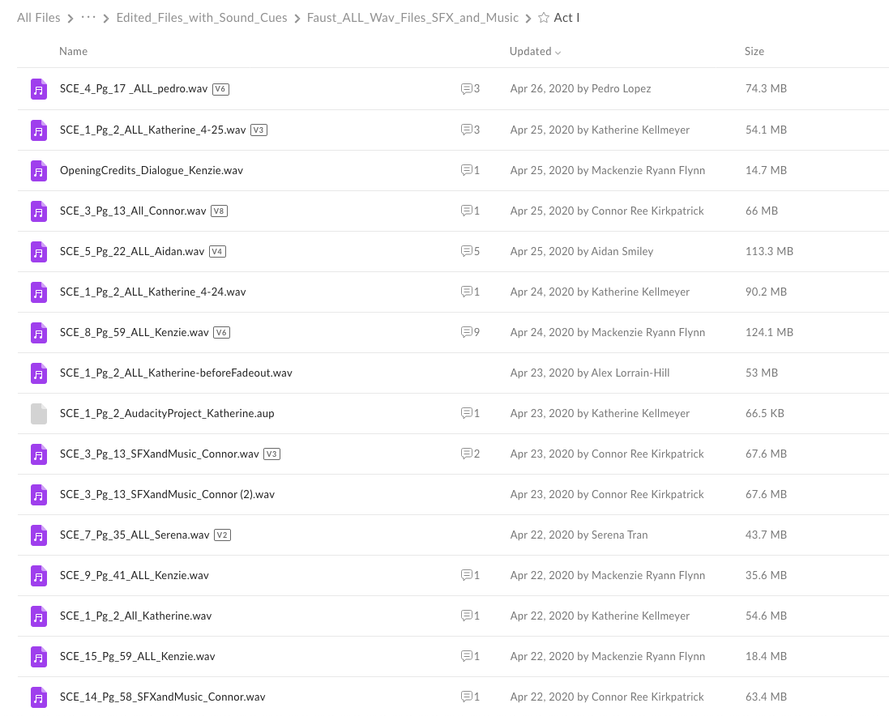
Examples - File Names
Notes:
The entire radio play ended up being over 2 hours long and had over 5,000 files by the end that all culminated and was presented on a website that had designer interviews and ephemera. Thank you for viewing this presentation and the next one we have up on virtual performance is the Rehearsal/Tech presentation. Have a great day and season!

