Slide 1
Augusto Boal
Theatre of the Oppressed
Theatre for Social Change
Excerpted from “Forum Theatre” by Kaz Chandler
which may be found in the Lesson Plan Library on TE Pro

Slide 2
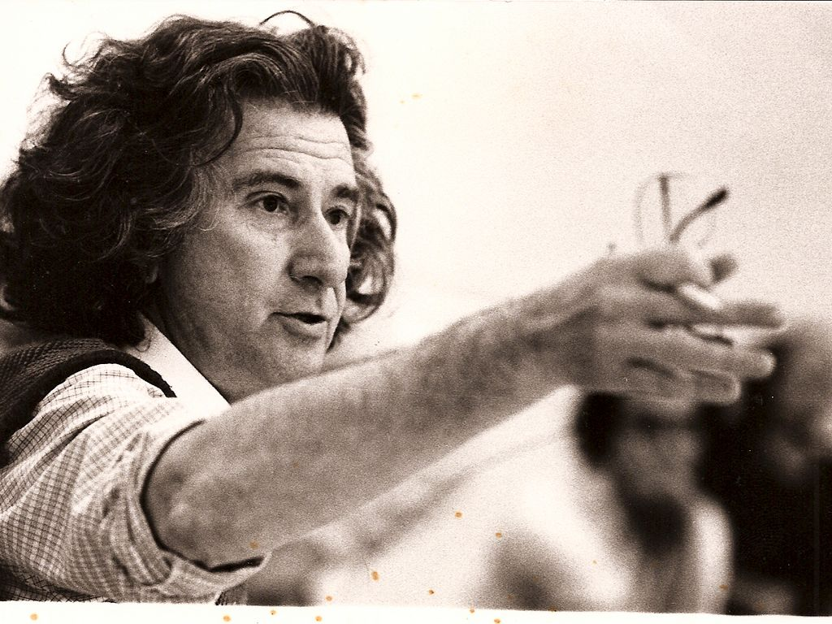
Augusto Boal
1931-2009
Brazilian theatre director, writer and politician
Originally studied to be an engineer
Founder of Theatre of the Oppressed
In the early 1970’s, a revolutionary and considered dangerous he was kidnapped by the Brazilian government, jailed, tortured and exiled to Argentina.
He later traveled to Europe honing his craft and continuing to work for Brazil and the world’s social justice.
Returned to Brazil and won political office in the early 90’s

Slide 3
Theory of Theatre of the Oppressed
Theatre should be used to promote change in society, politics or in yourself.
Boal used active dialogue with the audience as opposed to just performing “at” them.
His themes came from current news and politics.
3 Conventions he used to create theatre were “Invisible Theatre” “Image Theatre” and “Forum Theatre”.

Slide 4
Invisible Theatre
Invisible theatre is a form of theatrical performance that is enacted in a place where people would not normally expect to see one (for example in the street or in a shopping centre) and often with the performers attempting to disguise the fact that it is a performance from those who observe and who may choose to participate in it, thus leading spectators to view it as a real, unstaged event.
Invisible Theatre is about showing oppression in everyday life in an everyday setting without letting the spectators be aware of the fact that it is a performance.
It seeks to promote awareness of everyday oppression through performances that seem spontaneous, but are well-planned. It akin to graffiti or public demonstration. This theatre may be done in order to help the actors gain more knowledge of what reactions are elicited in different scenarios.

Slide 5
Image Theatre
In Image theatre, actors create a still image/tableau using their bodies and expressions to bring across certain messages, attitudes and emotions.
The image will then be played out for a short while (usually an actor will just repeat one short line, which is related to the message he was trying to bring across in the image, over and over again for a few seconds.) and the audience will then be asked to share what they have seen or the feelings the got after seeing the image.
Image Theatre allows one to practice the separation of objective and subjective analysis. It encourages audience to understand the difference between what one sees and what one assumes based on what he sees through the sharing afterwards. Image theatre develops a stronger understanding of the way images can be interpreted instead of just allow quick thought processes.

Slide 6
Forum Theatre
In a forum theatre, actors or audience members could stop a performance (which are usually life stories; if not scenes which are probable to happen in real life), often a short scene, in which the protagonist was being oppressed in some way. After the scene is being played out once, the actors will play it the second time. However, this time, the audience could stop the scene at any point of time they like and suggest different actions for the actors on-stage (or be the actor themselves) in an attempt to change the outcome of what they were seeing.
Just as the name suggests, it's a forum in itself and the performance would be open for discussion to anyone who participates.
Forum Theatre allows people to be more exposed to different ideas/views from different people to deal with a certain problem/issue. It allows the spectators to "give suggestions" on how the oppressed protagonist could have approached and handled the situation better and how he/she could have overcome that oppression. This gives any audience member who could relate to the scene or the oppressed protagonist a sense of liberation knowing that they can overcome their oppression.

Slide 7
The Joker
The Joker is the facilitator of the Forum experience.
In rehearsals and workshops, the joker guides actors though games and exercises to investigate shared experiences of oppression.
The Joker can also help actors develop scenes to share these experiences with an audience.
At a Forum Theatre performance, the Joker’s role is part MC, part moderator of the forum, calling on audience/spect-actors to discuss the oppression(s) in the play, and inviting them to enter the scenes to improvise creative strategies.

Slide 8
The Spec-Actor
Prior to his experimentation, and following tradition, audiences were invited to discuss a play at the end of the performance, remaining as only spectators.
In the 1960’s Boal developed a process whereby audience members could stop a performance and suggest different actions for the character experiencing oppression, and the actor playing that character would then carry out the audience suggestions.
But in a now legendary development, a woman in the audience once was so outraged the actor could not understand her suggestion that she came onto the stage and showed what she meant.
For Boal this was the birth of the spect-actor (not spectator) and his theatre was transformed. He began inviting audience members with suggestions for change onto the stage to demonstrate their ideas.
In so doing, he discovered that through this participation the audience members became empowered not only to imagine change but to actually practice that change, reflect collectively on the suggestion, and thereby become empowered to generate social action.
Theatre became a practical vehicle for grass-roots activism.

Slide 9
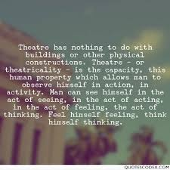
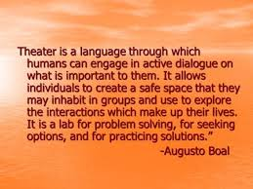
“Theatre is a form of knowledge; it should and can also be a means of transforming society. Theatre can help us build our future, rather than just waiting for it." ~”
― Augusto Boal

Slide 10
To answer the question all students ask when creating original work, “ How long should this be?”:
“When does a session of The Theatre of the Oppressed end? Never — since the objective is not to close a cycle, to generate a catharsis, or to end a development. On the contrary, its objective is to encourage autonomous activity, to set a process in motion, to stimulate transformative creativity, to change spectators into protagonists”...Boal

