Slide 1
Tech Theatre Tool Kit
Introduction and Slide Master

Slide 2
Designed and Created by Brandon Goodman
Houston Texas brandonkgoodman@katyisd.org

Slide 3
Unit 1- Introduction
Week | Days | Objective | Standards | Essential Questions | Paperwork | Notes
Aug 14 - 16 | 3 | Introductions | TH:Cn10.1.I. TH:Cn10.1.II. TH:Cn10.1.III. | How do you connect to the world of theatre? | Core Values, Elements of Design, Personality Types
Aug 19 - 23 | 5 | Types of Stages | TH:Cn10.1.I. TH:Cn10.1.II. TH:Cn10.1.III. | What essential elements are needed for a theatrical performance? |  | 21st - PAC TOUR
Aug 26 - 30 | 5 | Theatre History | TH:Cn10.1.I. TH:Cn10.1.II. TH:Cn10.1.III. | How has society shaped the way we view theatre through performance spaces? | Types of Stages Quiz
Sept 3 - 6 | 4 | Stage Diorama | TH:Cn10.1.I. TH:Cn10.1.II. TH:Cn10.1.III. | What elements of the space have stayed constant over the history of Theatre?
Sept 9 - 13 | 5 | Tool Safety | TH:Cn10.1.I. TH:Cn10.1.II. TH:Cn10.1.III. | How can we incorporate the 5S model into our daily lives? | 5 - S
Sept 16 - 20 | 5 | Tool Application | TH:Cn10.1.I. TH:Cn10.1.II. TH:Cn10.1.III. | How does a clean workspace affect productivity? | Tool Test | Production Week

Slide 4
TECHNICAL THEATRE
WEEK 1
Notes:
Presenter
2019-11-18 15:53:26
--------------------------------------------
Here is a very brief look at the master slide I create and share with students. I use this a guide for them as well as an accountability practice for anyone who is absent or falls behind. They can always go back and review before tests or quizzes. This is also a good way to look at what they are working on or need to complete - “Last edit Made”

Slide 5
Day 1 – Set up Google Slides
Tip: Click File - Make A Copy - Save to your drive so you can make any changes needed - DO NOT EDIT THIS FILE - ONLY EDIT YOUR COPY!
TIP: Once you have collected all emails - share your copy with your students and continuously add to it throughout the year! That way students always have access and can refer back to everything you have gone over for the year!)
https://www.youtube.com/watch?v=kYA6GLAzz9A

Slide 6
Next slides are blank for your use in setting up your own introduction to tech theatre PowerPoint
Notes:
Presenter
2019-11-18 15:53:27
--------------------------------------------
Here is a very brief look at the master slide I create and share with students. I use this a guide for them as well as an accountability practice for anyone who is absent or falls behind. They can always go back and review before tests or quizzes. This is also a good way to look at what they are working on or need to complete - “Last edit Made”

Slide 7
Welcome To Stagecraft
Add Your Logo Here
Notes:
Presenter
2019-11-18 15:53:27
--------------------------------------------
I have left image spaces for you to use to customize your presentation.

Slide 8
What is Stagecraft?
* Stagecraft is the creation of technical elements used in a theatrical production.
Stagecraft covers several different areas of a theatrical production.

Slide 9
What is Theatre?
Theatre -
Art Form - Theatre
Place - theater
Think of it as an action!
is an art form concerned almost exclusively with live performances in which the action is precisely planned to create a coherent and significant sense of drama.

Slide 10
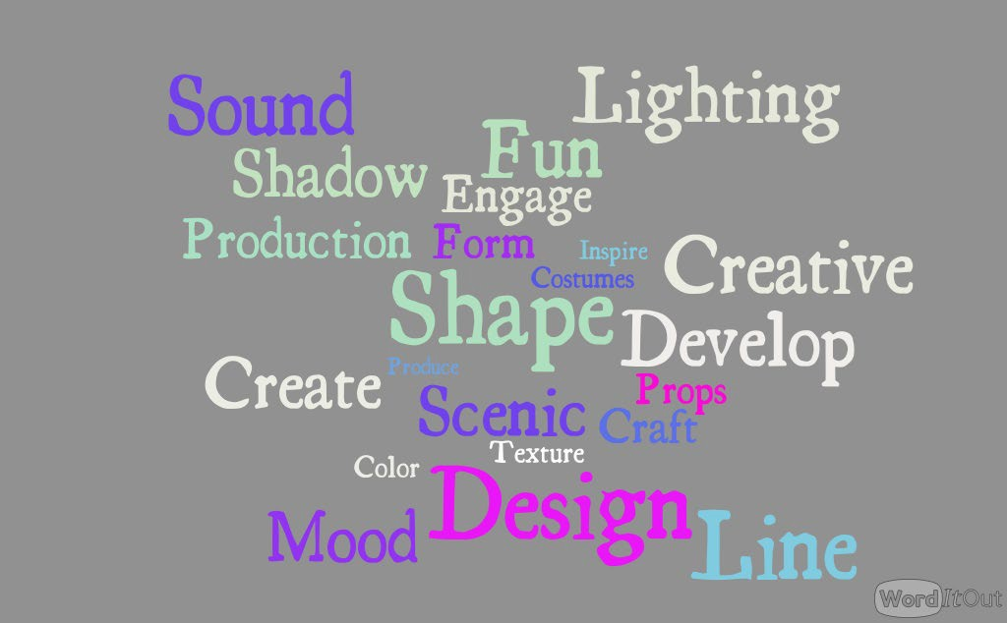
Stagecraft Word Wall
W
s y
W

Slide 11
Technical Theatre
What we will cover…

Slide 12
Scenic Design
Add Photo
Add Photo
Add Photo

Slide 13
Scenic Design
Set Construction - Building
Rigging - Counterweight System
Painting Techniques
Scale Model
Diorama
Add Photo

Slide 14
Lighting -
Add Photo
Add Photo
Add Photo

Slide 15
Lighting
Add Photo
Color Theory
Hang and Focus
Gobos and Gels
Light plot rendering
Specialty Lighting - Moving Lights
Light Board Operation

Slide 16
Sound -
Add Photo
Add Photo
Add Photo

Slide 17
Sound
Add Photo
Microphones
Sound Design
Special Effect Sounds
Soundboard Operation

Slide 18
Costumes -
Add Photo
Add Photo
Add Photo

Slide 19
Costumes
Costume Design - Renderings
Costume Construction - Sewing
Add Photo
Add Photo

Slide 20
Props
Add Photo
Add Photo
Add Photo

Slide 21
Props
Add Photo
Prop Design
Prop Construction
Add Photo

Slide 22
Hair and Makeup
Add Photo
Add Photo
Add Photo

Slide 23
Hair and Makeup
Hair and Makeup Renderings
Hair and Makeup Application
Add Photo
Add Photo

Slide 24
2019-2020 Productions
Add Photo
Add Photo
Add Photo
Add Photo

Slide 25
Stagecraft is for everyone
If you are interested in working with an award winning program and like getting your hands dirty, you have come to the right place.

Slide 26
About Me….
(Insert Teacher Name)
Add more slides with images that reflect your teaching style - refrain from overly personal images or text.
Let them see your passion for learning and theatre

Slide 27
Remind 101
Text 81010 @
Remind 101 - Use for class communication and updates
Student Email Access - get from your AP or registrar
- Have students either access or set up an email account
Google Drive -
- Have students log in and create a google drive account (free)
MY EMAIL ADDRESS:
(Once you have set up your google slide - share with my email.
Save your slide presentation as Firstname.lastname.classperiod)

Slide 28
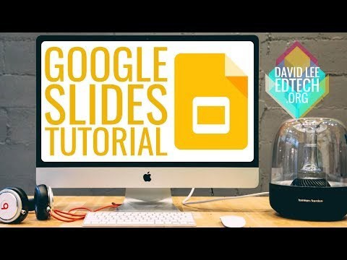

Slide 29
course?
(Insert your **website or Google drive here)
We will be using this website all year!
** Weebly is a very easy website developer to use click below to see the website we use
www.Mavericktheatrecompany.org

Slide 30
Teamwork makes the Dreamwork
Personality Quiz Link (QR CODE)
(Add results to shared google slide)
Notes:
Presenter
2019-11-18 15:53:28
--------------------------------------------
We use several ways to identify student learning styles, group dynamics, and personality types to help students become comfortable in our working environment. It's also a fun way to get to know where they are and what areas best fit their abilities.

Slide 31
What did you learn about yourself in these fun quizzes?
Did you agree?

Slide 32
(insert your theatre or school)
Core Values
People Matter
Strive for Excellence
Define success.
Be open to and embrace positive change. Learn and document new ways to improve
Take risks - turn both successes and failures into lessons learned.
Every individual has the opportunity to make a difference. Take care of yourself and your company.
Cultivate each person’s skills, strengths, and talents.
Be respectful, considerate, and honest with each other.
Work Together
The best ideas, performance, and results come through collaboration. Focus on the objective and challenge ideas, not people.
Be kind, assertive and supportive, even when there is disagreement. Work through conflicts, do not avoid them.
Work towards the same goal…….Support the final decision.
Be the person you want to work with
Celebrate individuality and honor diversity. Engage fully.
Bring positivity and enthusiasm to your work

Slide 33
Core Values Activity
Which Core Value do you most identify with?
How are these effective with a team mentality? Which one will be your biggest challenge?
How can these values apply outside of class?
Using the template below (Print these for them) -
What core value best represents your style?
The Core Value that I identify with the most is………

Slide 34
Elements of Design
Cheat Sheet:
Line
Color
Texture
Size
Shape
Value
Space

Slide 35
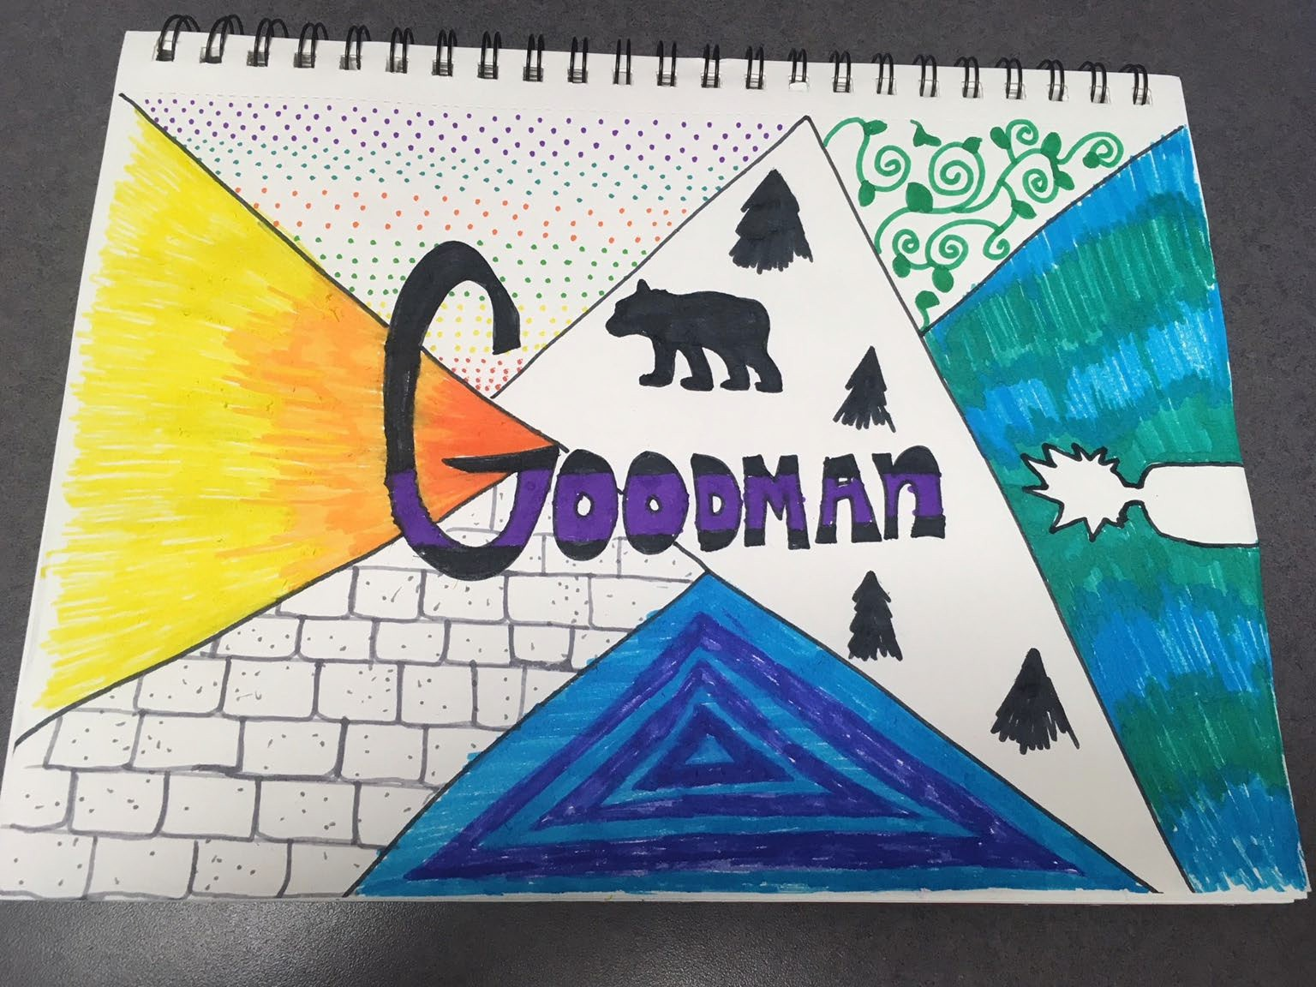
Use the Elements of Design to create a nameplate that
(Give students a sheet of paper, colors, markers, a ruler, and time!)
(Once they complete the assignment - have them add it to their shared slides)

Slide 36
About Me Presentation
Present your Design Nameplate
Share your Pottermore House (Who else is one?)
Personality Type - Did you agree with this? Why or Why
not?
What are you looking forward to the most this year

Slide 37
About Me Presentation Guide
Slide 1 - Design Name Plate
Slide 2 - Pottermore Slide (Add images of other famous people in your house and add image of house crest)
Slide 3 - Personality Type
Key parts that stood out the most to you.
Slide 4 - What area of technical theatre are you most excited?
Add images to help show the area.

